Slide 1
Binomial Distribution

Slide 2

Flipping a coin (not fair)
P(H) = 0.7 P(T) = 0.3
Define a random variable Z:
Z= 1 if heads, 0 if tails
What is the probability distribution of Z?
Bernoulli distribution
E(X) = ? Var(X) = ?

Slide 3
Flipping a coin (not fair)
P(H) = 0.7 P(T) = 0.3
Define a random variable X:
X = the number of heads after 10 flips
10 Bernoulli trials
Binomial random variable

Slide 4
A binomial setting arises when we perform n independent trials of the same chance process and count the number of times that a particular outcome (called a “success”) occurs.
Binary? The possible outcomes of each trial can be classified as either “success” or “failure.”
Independent? Trials must be independent.
Number? The number of trials n of the chance process must be fixed in advance.
Same probability? There is the same probability of success p on each trial.

Slide 5
A binomial setting arises when we perform n independent trials (Flips) of the same chance process and count the number of times that a particular outcome (called a “success”) occurs (e.g. count the number of heads).
Binary? The possible outcomes of each trial can be classified as either “success” or “failure.” H or T
Independent? Trials must be independent.
Number? The number of trials n of the chance process must be fixed in advance. n=10
Same probability? There is the same probability of success p on each trial.
P(H) = 0.7

Slide 6
Define a Random Variable Y:
Y = the number of kings after taking 2 cards from standard deck without replacement
Binomial Random Variable?
Binary?
Independent?
The number of trials n of the chance process must be fixed in advance ?
Same probability?
WITH

Slide 7
Binomial Random Variable
Def: The count of successes X in a binomial setting is a binomial random variable. The probability distribution of X is a binomial distribution.
The possible values of X are 0, 1, 2, …, n.
Any binomial distribution is completely specified by two numbers:
the number of trials n of the chance process
the probability p of success on each trial.

Slide 8
Flipping a coin (not fair)
P(H) = 0.7 P(T) = 0.3
Define a random variable X:
X = the number of heads after 10 flips
What is the probability of X ?

Slide 9

When the probability of success is p, the probability that a binomial random variable, X, has exactly x successes for n independent trials, is calculated as
This is the binomial probability function.
E(X) = np
Var(X) = np(1-p)

Slide 10
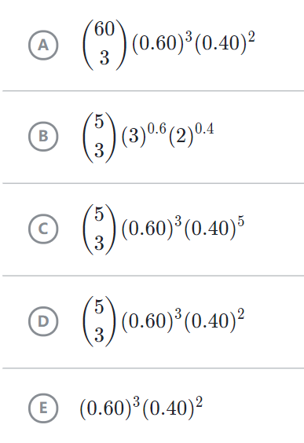
Practice
Heather has a weighted coin that has a 60 percent chance of landing on heads each time it is flipped. She is going to flip the coin 5 times.
Which of the following would find the probability of Heather getting exactly 3 heads in 5 flips of her weighted coin?

